Slide 1
Some Computer Science Issues in
Ubiquitous Computing
Communications of the ACM (CACM) Vol. 36, No.7, July 1993
M. Weiser
Presented by Hwajung Kim (hkim@dcslab.snu.ac.kr)
DCSLab, SNU

Slide 2
Table of Contents
Background
Ubiquitous Computing
XEROX PARC Prototypes
Issues
Conclusion

Slide 3
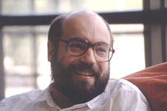
Background
Mark D. Weiser (1952 ~ 1999)
Chief Scientist at XEROX PARC*
Father of Ubiquitous Computing
  Coined the term “ubiquitous computing” in 1988
“In the 21st century the technology revolution will move into the everyday, the small and the invisible…”
“The most profound technologies are those that disappear. They weave themselves into the fabric of everyday life until they are indistinguishable from it”
*PARC: Palo Alto Research Centre Incorporated

Slide 4
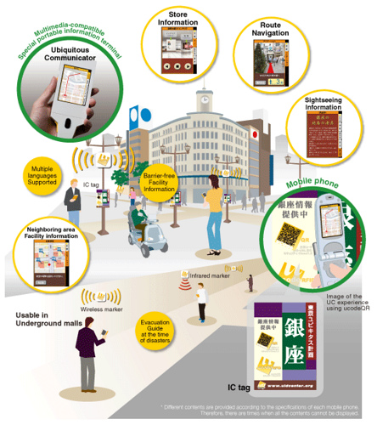
Ubiquitous Computing
Next generation computing environment/framework
GOAL
  Interacting with hundreds of
    nearby
    wirelessly
    interconnected computers
  Invisible to the user
    Disappearing from user’s awareness
“intimate computer”
“rather like a human assistant”

Slide 5
Ubiquitous Computing Principles
The purpose of a computer is to help you do something else
The best computer is a quiet, invisible servant
The more you can do by intuition the smarter you are; the computer should extend your unconscious
From one of his talk “Computer Science Challenges for the Next 10 Years”
Weiser, Mark (Nov. 1, 1996)
Youtube: https://youtu.be/7jwLWosmmjE

Slide 6
XEROX PARC Prototypes
Inspired by everyday life objects which capture or convey information
New kind of computer
  Concrete information conveyer
  Many sizes & shapes
  Inexpensive
3 different sizes of devices
  Tab analogous to tiny individual notes, post-it
  Pad analogous to scrap paper, cluttered office desk, messy front-hall table
  Board analogous to office whiteboard, home magnet-covered refrigerator, bulletin board

Slide 7
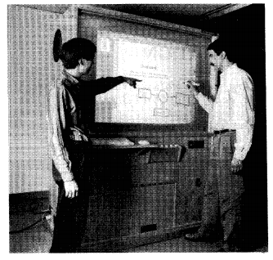
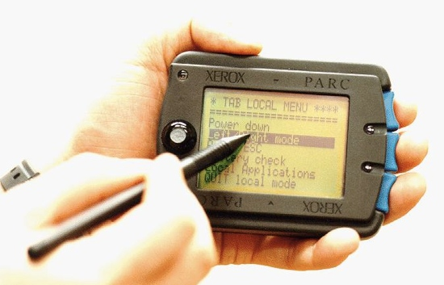
XEROX PARC Prototypes
Interaction S/W
Necessary H/W
Physical Size
Power Consumption
ParcTab
Live Board
Source
. Liveboard (http://www.kraka.com/DesignPortfolio/liveboard.html)
. Liveboard: A large interactive display supporting group meetings, presentations and remote collaboration. Elrod, S., Bruce, R., et al. CHI’92

Slide 8
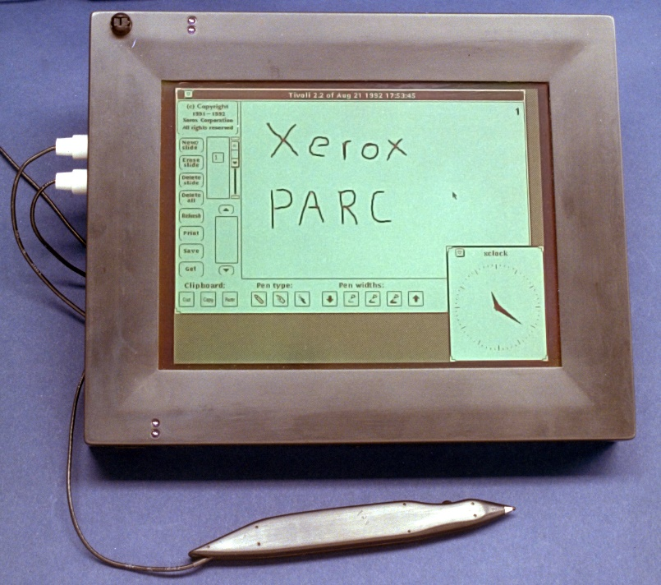
XEROX PARC Prototypes
Necessities
Correct balance of features
Requirements for particular features
- Pen emphasis, connection to research environments
Ease of expansion and modification
ParcPad
Source
. Liveboard (http://www.kraka.com/DesignPortfolio/liveboard.html)
. Liveboard: A large interactive display supporting group meetings, presentations and remote collaboration. Elrod, S., Bruce, R., et al. CHI’92

Slide 9
The Computer Science of Ubicomp
Hardware Components
Network Protocols
Interaction Substrates
Applications
Privacy of Location
Computational Methods

Slide 10
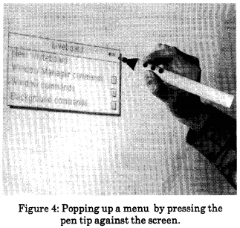
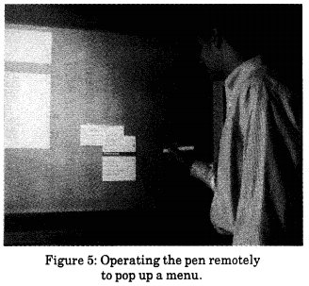
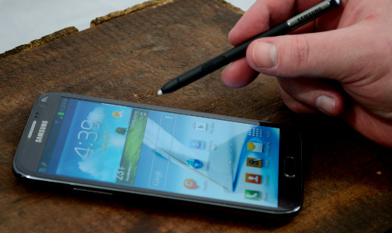
Issues – Hardware Components
Low Power
  High Performance vs. Power Consumption
  Using additional chip area to reduce power
  rather than to increase performance
  Reducing clock frequency by increasing pipelining or parallelism
Wireless
  Near-field radio communications
    Reuse same frequency
    Transceivers with low power
Pens
  Casual use, No training, Naturalness, Simultaneous multiple use
  New IR(infrared) pen
Power ∝ Voltage²
Source
. Liveboard: A large interactive display supporting group meetings, presentations and remote collaboration. Elrod, S., Bruce, R., et al. CHI’92

Slide 11
Issues – Network Protocols (1/2)
Wireless Media Access
MACA: Multiple Access Collision Avoidance
  Handshake RTS (Request to Send) / CTS (Clear to Send) btw two stations
  Fairness by back-off
  Real-time by NCTS(n) packet type (Not Clear To Send)
    Guarantee bandwidth for voice or video

Slide 12
Issues – Network Protocols (2/2)
Wide-bandwidth range
  Supporting Gb networking
Real-time protocols
  Support multimedia
Packet routing
  Support mobility
  Virtual IP (Sony) / Mobile IP (Columbia University)
    Adding a second layer of IP address
    “real” address with forward packets

Slide 13
Issues – Interaction Substrates
Tabs
  Very small interaction area
  Touch printing that uses only a tiny area
Live boards
  High interaction area; 400 times of the tab
  Conventional pull-down or pop-up menus
    Requires walking across the room
  Location-independent interaction; popped up at any location
X-Window System
  Move frequently from device to device; bring windows along
  Migration tool with low bandwidth

Slide 14
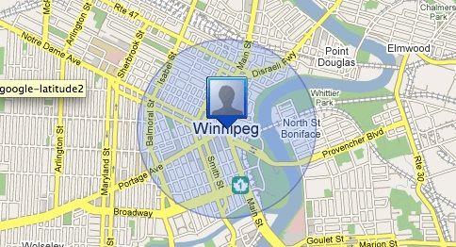
Issues – Applications (1/2)
Locating People
  Display of CSL activity from personal locators
  Active badge system
Example Uses
  Automatic phone forwarding
  Locating an individual for a meeting
  Watching general activity

Slide 15
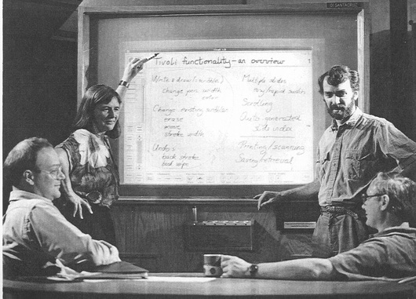

Issues – Applications (2/2)
Shared Drawing
  Pen-based drawing on a surface
  Simultaneous & Multi-user support on same/different pages
Issues for Optimal
  Multiple vs. One Cursor
  Gesture or NOT
  Single application with multiple windows VS. Many independent applications

Slide 16
Issues – Privacy of Location
Cellular systems
  Traveling pattern can be deduced from the roaming data
Preserving privacy of location
  Central database of location information
    Packet snooping, traffic analysis on source addresses
  Storing information at each person’s PC/Workstation
ONLY society can cause the right system to be used

Slide 17
Issues – Computational Methods
Optimal Cache Sharing
  Low Bandwidth & High Processing power
Solutions
  Optimal strategy for partitioning memory between compressed and uncompressed pages
  Methods to handle cache misses over high latency mediums

Slide 18
Conclusion
First phase of ubiquitous computing
Enter most productive period
  at the time of 1993
Ubicomp
  Provide a framework for interesting and productive work for many more years
Many of the issues and challenges had been solved!

Slide 19
Supplements - Virtual Reality VS. Ubicomp
Virtual Reality
  Goal
    Taking over human sensory and affector systems
  Problem
    Cost
      Cannot produce a simulation at reasonable cost
    Can’t fool the user
  Puts people inside a computer world
Ubiquitous Computing
  Goal
    Personal digital assistants
    Autonomous agents
  Forces the computer to live in the world with people

